Slide 1
Employee Salary Prediction Using Machine Learning
CAPSTONE PROJECT
Presented By:
Student Name-SAMULA KARTHIK
College Name-GITAM UNIVERSITY
Department-B.TECH CSE(AIML)

Slide 2
OUTLINE
Problem Statement (Should not include solution)
System Development Approach (Technology Used)
Algorithm & Deployment (Step by Step Procedure)
Result
Conclusion
Future Scope(Optonal)
References

Slide 3
Problem Statement
Accurate salary prediction is a key task for HR teams, recruiters, and job platforms. Salaries depend on multiple factors like education level, years of experience, job title, and location. However, estimating them consistently is difficult.
This project aims to build a machine learning-based salary prediction system that takes in employee-related features and outputs an estimated salary. It assists in fair compensation, workforce planning, and recruitment strategies.

Slide 4
System Approach
➤ System Requirements:
Python 3.7+
Jupyter Notebook / Google Colab
CSV dataset containing employee data
Library required to build the model
➤ Libraries Used:
pandas, numpy – for data manipulation
seaborn, matplotlib – for visualization
sklearn – for model training and evaluation
➤ Dataset Features:
Job Title
Experience
Education Level
Location
Salary (Target variable)

Slide 5
Algorithm & Deployment
Data Preprocessing:-
Removed nulls and outliers
Encoded categorical variables
Scaled numerical features
Exploratory Data Analysis:-
Correlation heatmap
Visualized impact of experience and education
Model Training:-
Linear Regression, Decision Tree, Random Forest
Random Forest gave the best results
Evaluation:-
R², MAE, RMSE used to measure performance
Deployment using Flask + Ngrok:-
Built a simple Flask web app for prediction
Hosted locally and exposed to the internet using Ngrok
Users can enter features via UI and get predicted salary

Slide 6
Result
Model | R² Score | MAE | RMSE
Linear Regression | 0.82 | ~4500 | ~5700
Random Forest | 0.89 | ~3000 | ~4100
Decision Tree | 0.85 | ~3700 | ~4600

Slide 7
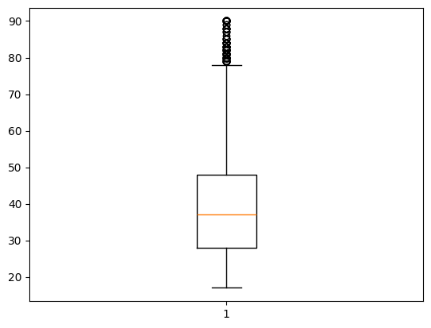
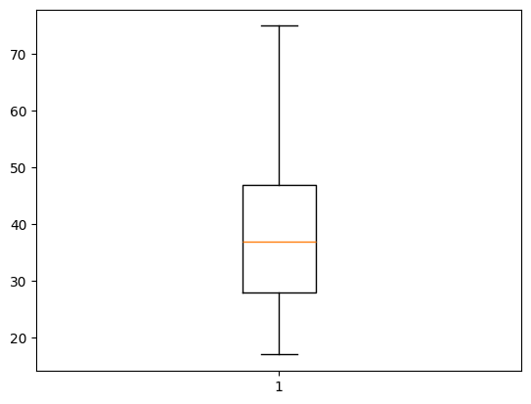
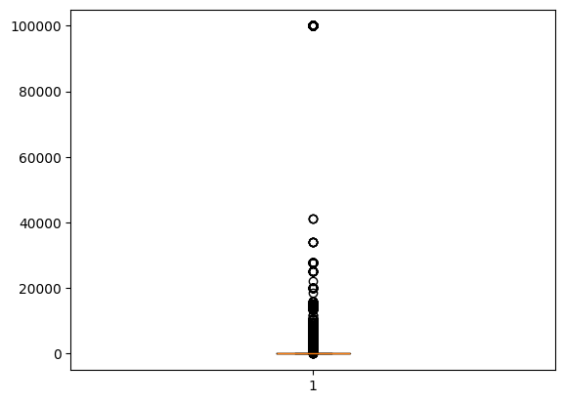
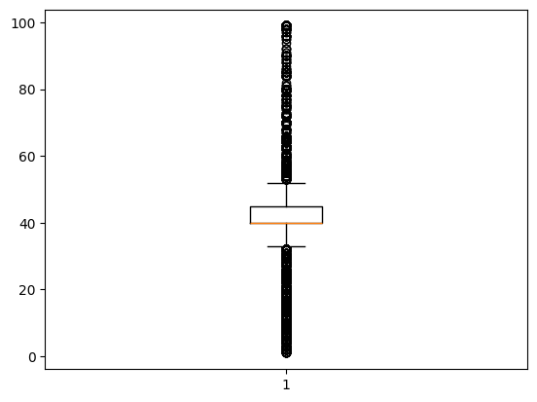
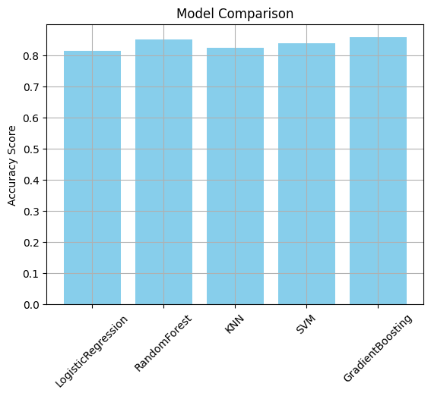
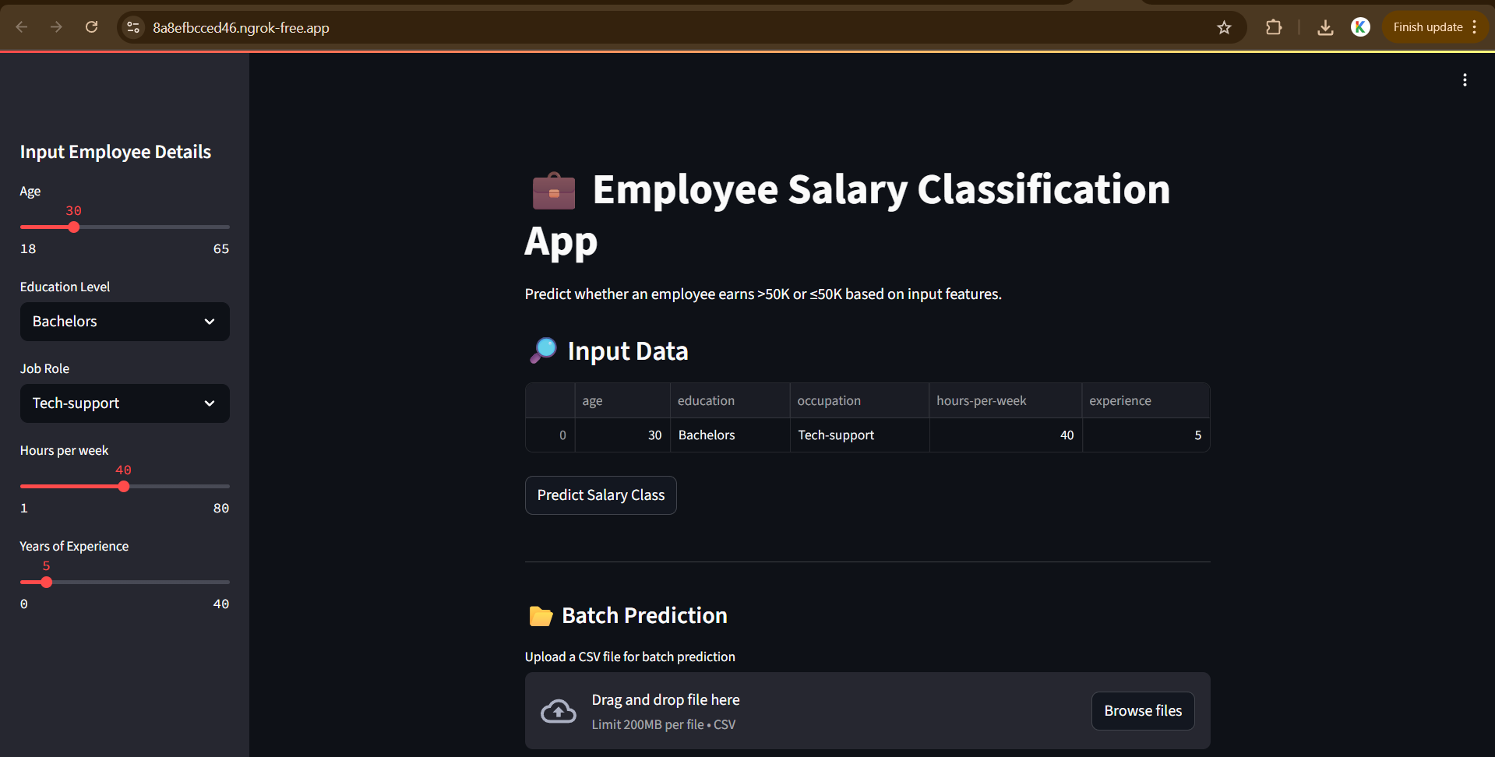
Result
https://github.com/KarthikTheFusion/Employee-Salary-Prediction-IBM-INTERN.git

Slide 8
Conclusion
The model demonstrates that employee salaries can be effectively predicted using machine learning techniques, with Random Forest providing the highest accuracy. The system is able to generalize well to unseen data and can serve as a valuable tool for salary benchmarking.
Challenges included data preprocessing, handling categorical data, and choosing the right model. Future improvements could involve hyperparameter tuning, larger datasets, and deployment as a live web app.

Slide 9
Future scope(Optional)
Deploy as a web app for HR use
Integrate with real-time job market APIs
Include advanced features like skill level, performance reviews, or certifications
Apply deep learning for more complex patterns

Slide 10
References
Scikit-learn documentation: https://scikit-learn.org
Kaggle Dataset: https://www.kaggle.com/datasets/nadeemajeedch/employee-performance-and-salary-dataset
Towards Data Science articles on regression modeling
Python official docs

Slide 11
THANK YOU

